Slide 1
Introduction to Data Science Data Mining for Business Analytics
Brian d’Alessandro
Adjunct Professor, NYU
Fall 2015
Fine Print: these slides are, and always will be a work in progress. The material presented herein is original, inspired, or borrowed from others’ work Where possible, attribution and acknowledgement will be made to content’s original source. Do not distribute, except for as needed as a pedagogical tool in the subject of Data Science.
Notes:
https://www.youtube.com/watch?v=aMDe5pODkB0 (harlan harris)

Slide 2
Thinking through constraints (through the lens of supervised learning)
Notes:
The goal of finding structure is to information from one source to reduce uncertainty about another source.
What does this mean? Conditional distribution example. I.e., carnival guy who guesses your weight. If I can see your height I can reduce uncertainty about weight.
Find some height/weight data.
Under supervised exploration:
How can we (automatically) obtain a selection of the more informative variables with respect to predicting the value of the target variable?
Even better, can we obtain the ranking of the variables?
Can think of importance as one that makes the target variable more pure. This leads to the notion of entropy.

Slide 3
Supervised vs. unsupervised
Supervised Learning: the process of inferring a function from labeled data. In SL, we have a target (dependent) variable Y and features (independent variables) X, and our goal is to learn a function Y=f(X).
Unsupervised Learning: the process of finding hidden structure in data that has no label.
Hint: If no label/target/dependent var, then it is probably unsupervised!
Notes:
Do the demo as well

Slide 4


Types of labels in sl
SL can be further broken down by the type of target variable.
In regression problems, the labels can be any real valued number.
In classification problems, the labels are discrete choices called ‘classes’, and one either estimates a particular class or the probability of being in a particular class.
or
Notes:
Do the demo as well

Slide 5
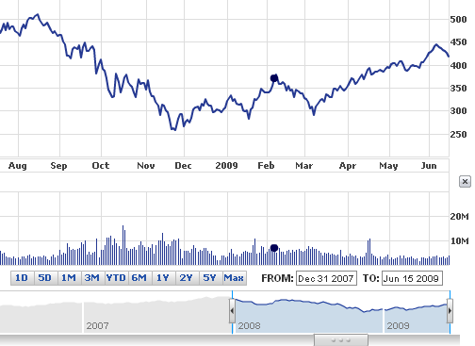

Example regression Problems
What will the price of IBM stock
be tomorrow?
How much will a new customer spend
In the next year?

Slide 6
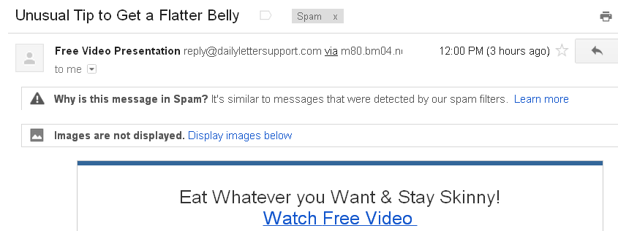

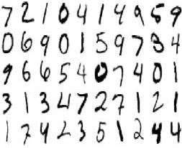

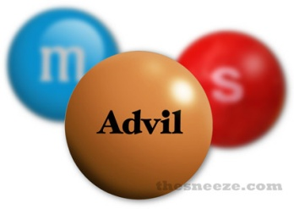
Example Classification Problems
Is this e-mail spam?: C=[No,Yes]
Will someone click on an ad?:
C=[No,Yes]
What number is this?:
C=[0,1,2,3,4,5,6,7,8,9]
What is this news article about?:
C=[Politics, Sports, Finance …]
Is this pill good for headaches?:
C=[No,Yes]

Slide 7
A Common Theme
Few problems have out of the box solutions
Given
Choose
Data/Sampling
Data
Classifier
Optimization Method
Problem
Loss Function
Constraints
Features
Evaluation Metric
The Data Scientist has to navigate these choices

Slide 8
Classification Algorithms
The following is a non-exhaustive list of popular algorithms used in classification problems:
Classic & Simpler Methods
Black Box but Powerful Methods
Decision Tree
Naïve Bayes
K- Nearest Neighbors
Linear Hyperplane
Random Forests
Non-Linear SVM
Neural Networks
We will NOT discuss each of these algorithms in detail in this course, but we will cover the process of how to choose one.

Slide 9
But which one should I use?
If world free of constraints, then (e.g. a data mining competition):
Try them all, choose best performer
Else:
Consider all constraints on your problem.
Choose best performer subject to constraints

Slide 10
Try them all???
Train = Training Data
Val = Validation Data
For each Algorithm in <set of all algorithms>:
Choose the Algorithm with the best out-of-sample error.
Build a classifier, F^{A}(X) using
Train
Get out-of-sample error of F^{A}(X) using
Val

Slide 11
Bakeoff rules
Training data must always be disjoint from validation data.
Use the same training data and validation data for each hypothesis being tested.
Given a tie (statistical or exact), choose the simpler model (sometimes this is subjective).
Use this methodology for all design decisions (feature selection, hyper-parameter selection, model selection, etc.)

Slide 12
Model selection
This is a generic term that has many flavors
The type of algorithm used (Naïve Bayes vs. Decision Tree)
The number of features used
The definition of the features used
The hyper-parameters used (usually related to regularization)
Regardless of how it is defined, use a rigorous validation process to choose. We will study this more in future lectures.

Slide 13
Constraints to consider
Do you have the right data?
Production data is often biased
The data for your problem might not exist (cold start, new product, etc.)
The right metric/outcome is unmeasurable (i.e., buys orange juice, or consumer happiness)
The outcome is so rare you barely observe it
Too little/too much data?
There are few observations but many variables (generally an estimation problem)
Too much data (generally a computation problem)

Slide 14

Constraints to consider
Do you understand the algorithm?
Your own personal knowledge is a constraint worth admitting to
You don’t have to master every algorithm to be a good data scientist
Getting the “best-fit” of an algorithm often requires intimate knowledge of said algorithm

Slide 15
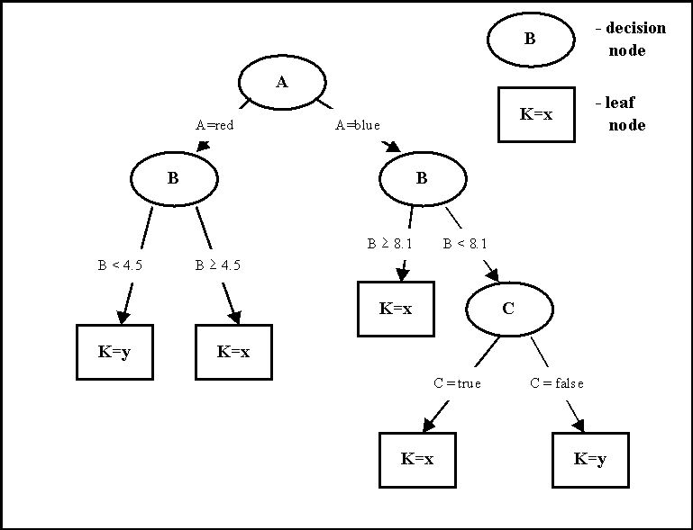
Constraints to consider
Do you need to interpret the model?
Decision Tree
Random Forest
Vs.
Very Easy
Very Difficult

Slide 16
Constraints to consider
Does scalability matter (learning time, scoring time, model storage)?
Decision Tree
Random Forest
Vs.
Fast/Small
Slow/Large

Slide 17
An Empirical Comparison of Classification Algorithms
Mean Normalized Scores of each Algorithm over 11 Different Data Sets
Scalability/Complexity/Interpretability
Performance
Source: An Empirical Comparison of Supervised Learning Algorithms http://www.niculescu-mizil.org/papers/comparison.tr.pdf

